Slide 1
First estimates of UK National Transfer Accounts
David McCarthy
27th January 2011
UK Treasury

Slide 2
Outline
The ageing society & the economic lifecycle
National Transfer Accounts (NTA’s)
NTA estimates for the UK
Cross-country comparisons
Applications
Are we life-cycle savers?
How much do children cost?
The response to public transfers to the elderly: lower savings, or higher bequests?

Slide 3
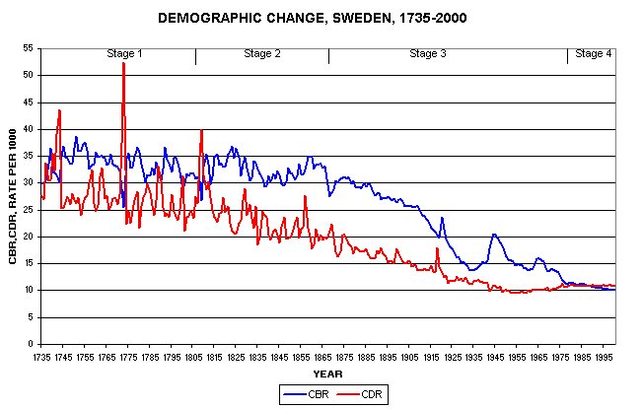
The ageing society
Societies all around the world are ageing
The fundamental cause is a demographic transition from high fertility – high mortality societies to low fertility – low mortality societies
(Primary cause of population ageing is low fertility)

Slide 4
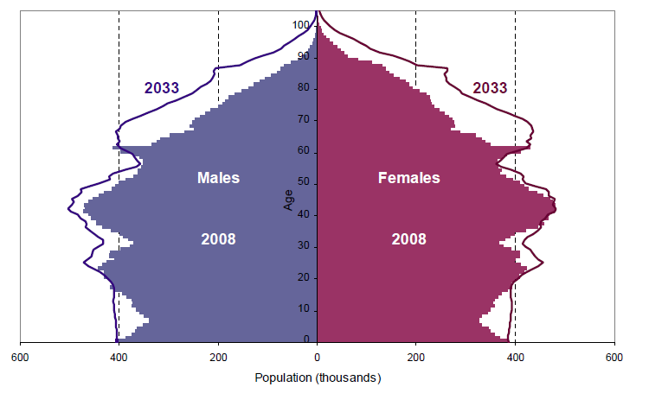
Demographic transition
In the future, the increase in the proportion of the population which is elderly will dominate population change
2008: 13.6% > 60
2033: 20.6% > 60

Slide 5
Economic lifecycle
Consumption exceeds labour income for the very young and the very old
Changes in population structure affect everyone

Slide 6
Population ageing presents major challenges
How sustainable are our transfer systems?
Public sector: Number of taxpayers will decline relative to number of beneficiaries
Private sector: Number of working-age adults will decline relative to dependent children and elderly
How resilient are our asset markets (housing / financial assets)?
If the elderly depend on selling assets to fund their retirement, how will asset prices respond to population ageing?
How sustainable is our political consensus?
What is the implication of population ageing for generational equity?

Slide 7
Literature review
Generational accounts (Kotlikoff, 1995, Auerbach et al, 1999)
Attempt to evaluate the sustainability of fiscal policy given its generational incidence
(Exclude private transfers, general equilibrium)
Evaluation of inter-generational equity (in the UK)
Hills (1992)
Cardarelli, Sefton and Kotlikoff (2000)
Banks et al (2000)
Sefton and Kirsanova (2006)
Barrell and Weale (2010)

Slide 8
National Transfer Accounts
Developed by Mason and Lee (1994), recent book Lee et al (2010), Elgar.
Attempt to understand the generational economy
Social and economic institutions which mediate age-related flows within an economy
Public sector, asset markets, families
Quantify the size, direction and nature of age-related economic flows in the economy
In a way which is consistent with other measures of economic output (National Accounts)
Ultimate goal:
Develop institutions which are sustainable in the face of the demographic transition
An international project, 31 countries (UK are latecomers)

Slide 9
National Transfer Accounts
Based on a flow accounting identity which states that for any individual, over any time period, consumption must be financed by a combination of labour income, transfers, asset income or dissaving:
Re-arranging the equation, and aggregating all individuals of the same age (x) together, yields:
This equation says that any deficit of consumption over labour income needs to be financed either by transfers, or by asset-based reallocations
(Difficulties: capital gains, incidence, general equilibrium)

Slide 10
Economic lifecycle: UK
Consumption exceeds labour income below age 23 and above age 57
Age 57
Age 23

Slide 11
Methodology and data sources
Basic principle is to use a nationally representative survey to estimate age profiles for the variable of interest
Smooth the profile using a Gaussian smoother
Use the national population to set the aggregate value implied by the smoothed profile equal to the appropriate control value from the National Accounts
We estimated 27 separate profiles (phew!) and used three surveys for our data:
Food and Expenditure Survey, 2006
Family Resources Survey, 2006
Wealth and Asset Survey, 2006/8
We used National Accounts data for 2007 from the 2008 Blue Book
(Data problems: students, care homes, age top-coding)

Slide 12
Numbers are consistent with National Accounts
£193bn , around 14% of GDP
£217bn, around 15% of GDP

Slide 13
Consumption profiles
Public health estimated using a combination of unit costs obtained from the DoH and utilisation measures from the GHS, separate profiles for males and females, 6% p.y.o.a. increase p.c. above age 80
Public education used enrollment data from the FES, unit cost data from the DoE
Private education / health used household expenditure data from the FES and a regression approach
Housing used rentals / heating / maintenance costs from FES plus imputed rentals for OOH, equivalence scale used to allocate between hh members
Private other included food, alcoholic beverages and tobacco, clothing and footwear, furnishings, household equipment and carpets, transport, communication, recreation, restaurants and hotels, and miscellaneous expenditure, equivalence scale to allocate between hh members
Public other was assumed to be independent of age

Slide 14
Components of consumption
Consumption includes both consumption of services provided by government (education, health care, defence etc), and private consumption

Slide 15
Estimating public transfers
Estimated age profiles using FES data for:
Government benefits
Pensions included BSP, S2P, widows pensions
Non-pension government benefits included all other government benefits
Taxes
Corporation tax allocated using investment income
Income tax allocated using FES
NI contributions allocated using labour income
Property taxes allocated using FES
Indirect taxes (mainly VAT) allocated by consumption
Other taxes allocated by FES and consumption

Slide 16
Estimating private transfers
Fall into three categories
Inter-household transfers were estimated using (unreliable?) FES data on cash sums paid to non-hh members and regular allowances received from outside the hh, smoothed and macro-control adjusted to equal to net private transfers in the Blue Book
Intra-household transfers were estimated using a model which assumed that all members of the household paid any surpluses to the hh head, who used this (as well as asset income /dissaving) to make good any individual deficits with transfers
Bequests were estimated using joint and single hh profiles of total hh wealth (from WAS), assuming that spouse was heir if married and child/sibling if single. Total bequests came to £68bn, compared with £59bn from HMRC (investigating using BHPS, but undercounting).
ABR’s are the balancing item

Slide 17
Per-capita age reallocations, UK (2007)
Private transfers largely downward, few upward transfers
ABR’s largely positive, and significant
Public transfers upward and downward

Slide 18
Aggregate age-based reallocations, UK (2007)
Total public transfers upwards exceed transfers downward, £86bn or 6% of GDP
Total private transfers downward are £135bn or 10% of GDP
Total public transfers downward are smaller at £56bn or 4% of GDP

Slide 19
Balancing item: asset-based reallocations
Asset-based reallocations are the balancing item in the NTA
We separate into public and private (but public ABR’s are small)
Made up of
Asset income (six profiles, including distributed and undistributed earnings of corporations, capital share of hh mixed income, imputed rentals, and interest income and expense)
Savings (which must balance to total net national savings in the National Accounts), this is the true balancing item for the age profiles
We used financial wealth holdings (including private pension wealth) profile for asset income obtained from WAS data

Slide 20
Asset-based reallocations and saving
Does appear to be real dissaving at older ages (although most may be private pensions)
Most private saving occurs between the ages of 43 and 65
Asset income largely received after the age of 40, declines with dissaving

Slide 21
Components of consumption, UK (2007)

Slide 22
Comparison with other NTA countries
NTA results are available on the NTA website for project members (www.ntaccounts.org)
This allows detailed comparisons of NTA quantities between NTA countries
Chose a group of ‘peer’ countries to the UK
COUNTRY | YEAR
Austria | 2000
Germany | 2003
Hungary | 2005
Japan | 2004
Spain | 2000
Sweden | 2003
UK | 2007
US | 2003

Slide 23
Age profiles of consumption
All profiles scaled by average labour income between 30-49 in each country

Slide 24
Proportion of consumption at each age which is public
UK has average consumption at young ages but a low proportion of this is publicly financed
A much higher proportion of the consumption of the elderly is publicly financed

Slide 25
Components of 65+ consumption (synthetic cohorts)
Heavy reliance on assets and labour income to finance old-age consumption
Heavy reliance on transfers

Slide 26
Components of 0-19 consumption (synthetic cohorts)
Much less variation between countries than with old-age consumption
UK relies more heavily on private transfers than its peer countries appear to do, including the US

Slide 27
Applications: Are we life-cycle savers?
Previous attempts to test the life-cycle model of consumption and saving have suffered from the problem that they have not had a comprehensive measure of wealth, including (private) transfer wealth
NTA’s provide this measure of wealth (provided you are willing to make some strong assumptions)

Slide 28
Some theory
Consider a life-cycle model of consumption and savings, with no bequest motives, no uncertainty, labour and transfer income, and mortality:
Model solution given by:

Slide 29
Average propensity to consume out of wealth
Average propensity to consume out of total wealth at age i is defined as:
Which using the solution to the model can be rewritten as:
(Which in turn allows us to estimate rho by age, provided we know r, gamma and the mortality probabilities)

Slide 30
NTA-derived APC, by age (UK, 2007)
Using NTA-derived estimates of total wealth at each age, and NTA consumption profiles, we can obtain the APC at each age
Estimates compare well with Sefton & Kirsanova (2006)

Slide 31
Estimated subjective discount factors, by age, UK (2007)
(Slope depends heavily on assumed level of risk aversion)

Slide 32
Applications: How much does it cost to raise a child?
There is a huge literature on the determinants of fertility, parental investment in children, and the role of bequests, going back to Becker, 1974.
NTA’s allow at least reasonable estimates of the cost – public and private – of raising a child
In the UK, PV of private transfers to a child between 0 and 19 are £140,000, public transfers are £57,000 (around 8.6 years of labour income on average)
0-19 | Labour income | Private transfers | Public transfers | ABR's | TOTAL
Austria | 1.1 | 3.4 | 3.3 | 0.2 | 8.1
Germany | 0.3 | 4.3 | 2.9 | 0.1 | 7.7
Hungary | 0.1 | 3.0 | 4.6 | 0.1 | 7.8
Japan | 0.2 | 5.0 | 4.4 | 0.1 | 9.7
Spain | 0.4 | 5.1 | 3.0 | -0.1 | 8.3
Sweden | 0.5 | 4.4 | 3.8 | 0.1 | 8.7
UK | 0.8 | 5.5 | 2.3 | -0.1 | 8.6
US | 0.3 | 4.7 | 3.5 | 0.1 | 8.6

Slide 33
Applications: Response to higher old-age transfers
Two schools of thought in economics on the response of individuals to higher transfers to the elderly
Feldstein (1974): individuals save less in anticipation of receiving larger transfers
Barro (1974): individuals may bequeath more in response to larger transfers having been received (undoing the effect of the transfers)

Slide 34
Components of 65+ transfer mechanisms
Since private transfers are small, there is almost a one-for-one trade-off between ABR’s and public transfers
But do Swedes/Hungarians/Austrians save less or bequeath more?

Slide 35
Saving appears high in high-transfer countries.........
Very high savings as a proportion of average income 30-49 in the UK between ages 50 and 60. Is this result confirmed in any other work?
… suggesting that bequests must be higher there too?

Slide 36
Total savings (65+) vs. Public transfers / LCD
Absolute level of savings appears to be higher in countries where a higher proportion of the LCD is financed by public transfers
What about bequests?

Slide 37
Conclusion & future work
NTA’s for the UK appear to indicate that we transfer less to young people than our peer countries (more to older people, especially the very old) even controlling on the level of consumption
UK public age-based reallocations appear quite low
Our children are quite reliant on private transfers, with possible implications for inter-generational transmission of inequality
Our older people are quite reliant on asset-based reallocations relative to other countries
We illustrated some potential applications of NTA’s
Currently assessing whether NTA methodology can shed light on differential savings patterns within sub-groups of the UK population

