Slide 1
Human Capital and Development in Kenya: Health, Education and Labor Income Profiles, 1994 and 2005
Moses Muriithi
Reuben Mutegi
Germano Mwabu
University of Nairobi, Kenya
Presented at NTA conference, Peking University, Beijing, China
10th -15th November 2014

Slide 2
1. INTRODUCTION
Long Term National Plan for Kenya, KENYA _VISION_2030, recognizes the role of human capital in development.
Health and education are identified as vital ends in themselves and as means of national development.
But Plan lacks information on:
Vision identifies human capital development as a key foundation for national socio-economic transformation
Since 1994-several policy interventions - aimed at promoting human capital development especially in the area of education and health

Slide 3
INTRO…
-- (a) Expenditure on on health and education services by age and gender;
-- (b) Productivity of human capital or its return, by age and gender;
-- (c.) Human capital created within households or in household enterprises, esp. by women.

Slide 4
INTRO…
The above kind of information is needed to design policies that would promote:
Human capital formation (hlth & ed) by age;
Social protection by gender;
Development of tools to count human capital produced at home and in family enterprises.

Slide 5
2. CURRENT POLICIES TO ENHANCE HUMAN CAPTAL HAVE SHORTCOMINGS
2.1 Education Policies
-- Current major policies include:

Slide 6
Free Primary Education;
Subsidised Secondary Education;
Parallel (unsubsidized) degree programs at all universities
Higher Education Loan Board

Slide 7
Education policies…
-- The Higher Education Loans Board (HELB) offers loans to students both in public and private universities;
Licensing of private schools;
-- [created unintended expansion in private primary schools due to (a) low quality education offered in Free Public Schools and (b) desire to get subsidies granted by National Treasury].
University Charters which have encouraged rapid expansion of universities.

Slide 8
MAJOR POLICY GAPS
There is no data to show how policies influence schooling and spending at different ages, by gender.
The policies ignore the time used at home or at household enterprises, especially by women, to support or complement formal schooling. [Same for the health sector].
-- Household budget &Time use surveys needed.

Slide 9
2.2 Health Policies
Free Maternity Care;
Free treatment of children;
Free ARVs;
Subsidized bed-nets;
Free vaccinations.

Slide 10
3. IMPROVING SOCIAL POLICIES: NTA & NTTA EVIDENCE NEEDED
-- NTA and NTTA profiles can reveal variations in health and education expenditures by age, gender, region and year of survey data.
-- They can suggest (or be used to consider) ways to improve social policies.
use 1994 and 2005/06 household surveys to approximate the effect of these policies

Slide 11
4. EDUCATION, HEA LTH AND LABOR INCOME PROFILES FOR KENYA, 1994 AND 2005
Education Profiles

Slide 12
PUBLIC EDUCATION CONSUMPTION
1994
2005

Slide 13
Private Education Consumption
1994
2005

Slide 14
Total public and total private education consumption
1994
2005

Slide 15
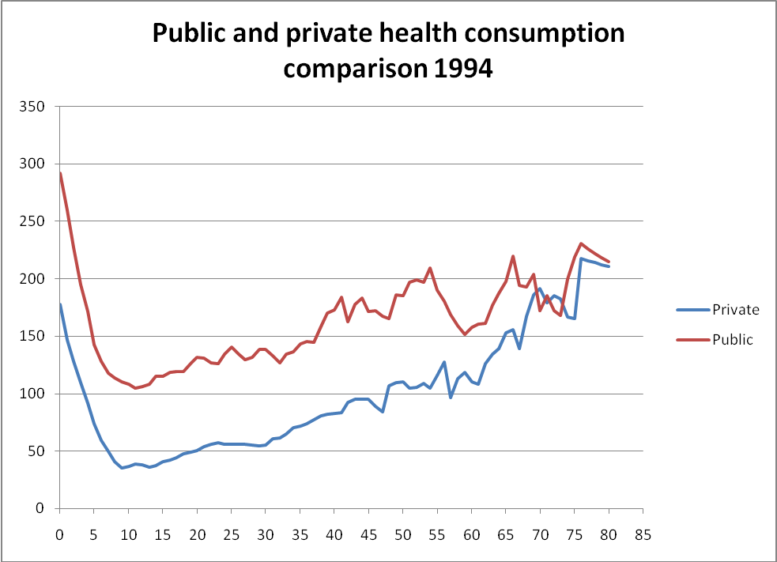
Health profiles

Slide 16
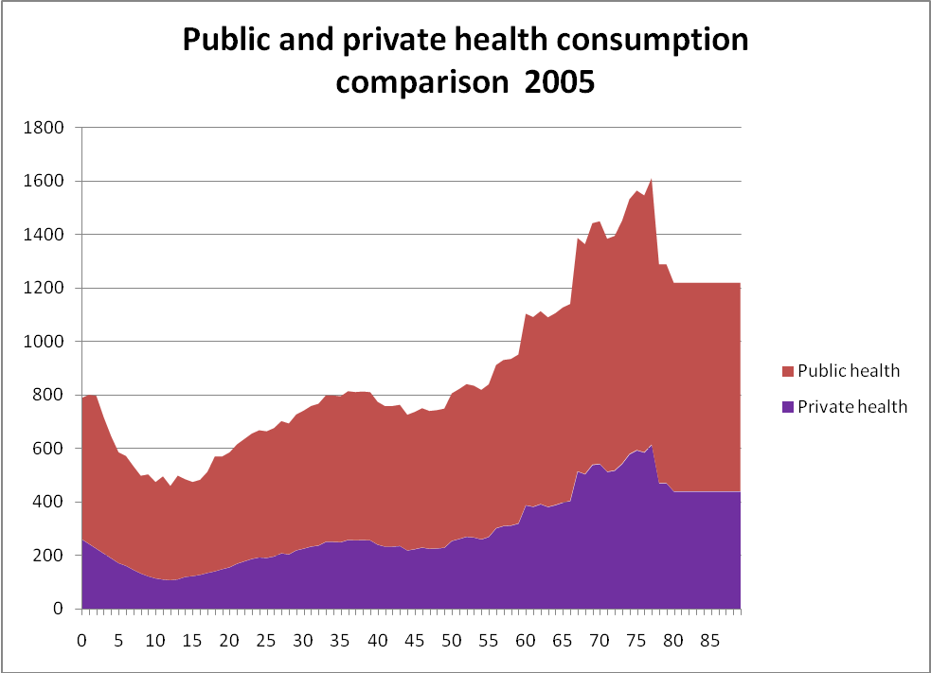

Slide 18
Labor Income Profile, 1994 & 2005

Slide 19
NTTA Profiles
Can help design better social policies around work, equity and human rights

Slide 20
Unpaid Family Workers

Slide 21
Time Use in Household Enterprises, by Gender

Slide 22
Thank you

Slide 23
NOTES
-- Time use analysis is performed on both market or non-market economies. -- For the market economy NTA frame work is used. -- The CWW methodology disaggregates NTA by gender and counts goods and services excluded from NTA.

Slide 24
--For non-market services unpaid household services are included in the NTA framework -- NTTA combines data from time use and wage surveys to measure time men and women spend in unpaid production. NTTA is linked to gender because women’s work, especially, is not captured in NTA

Slide 25
Steps in doing NTTA: -- Identify available time use survey by age -- Identify time spent on household work -- Find appropriate wages to impute value -- Construct NTTA for men and women.
NTTA graphs: examples

