Slide 1
Fertility, mortality, and economic development: An Analysis of 201 Countries during 1960-2010
Qingfeng Li
Li Liu
Amy Tsui
Saifuddin Ahmed

Slide 2
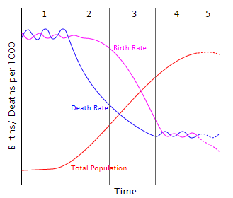
Demographic transition
Graph source: http://en.wikipedia.org/wiki/Demographic_transition

Slide 3
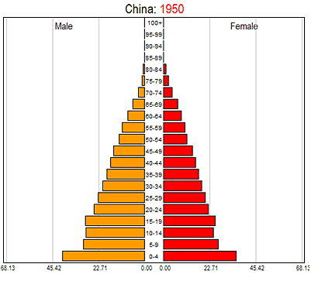
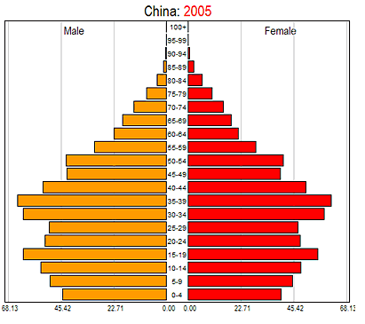
Graph source: http://en.wikipedia.org/wiki/Demographic_transition

Slide 4
Change in GDP per capita during 1990-2010 and the ratio of children to working age population in 2010 in Asia, LAC, and SSA

Slide 5
Objectives
To estimate the relative contribution of fertility and mortality decline during 1960-2010 on the favorable age structure shift.
To assess the economic impact of fertility and mortality reduction through population age structure shifting.

Slide 6
Method
Conducted decomposition analysis to disaggregate the effect of fertility and mortality changes on dependency ratios, which were derived from the counterfactual population growth projections under three scenarios:
(1) No fertility or mortality reduction during 1960-2010
(2) no fertility reduction during 1960-2010
(3) no mortality reduction during 1960-2010
We also estimated how much lower the GDP per capita would be in 2010 in those three hypothetical scenarios

Slide 7
Population projection was conducted with cohort component method (CCM).
CCM is a demographic method used by UN for global population projection.
The fundamental formula for the CCM is,
P_{(t+n)} = P_{(t)} + B_{t}^{t+n} - D_{t}^{t+n} + IM_{t}^{t+n} - OM_{t}^{t+n}
$P_{t+5}={(S+B)}_{t,t+5}∗P_{t}$
where S and B are the transition matrix of the age-specific survival and birth rate

Slide 8
Analytical method for assessing the effects of DR shift on economic growth
By definition, GDP per capita can be broken down into GDP per worker and the share of working age population.
$y_{it}=\frac{Y_{it}}{P_{it}}=\frac{Y_{it}}{W_{it}}\frac{W_{it}}{P_{it}}=z_{it}w_{it}$
where $Y_{it}$ is the gross domestic product (GDP), $y_{it}$ is the GDP per capita, $P_{it}$ is the total population, and $W_{it}$ is the number of workers, $z_{it}$ is the product per worker, $w_{it}$ is the share of workers in country $i$ in year $t$.
We can calculate the GDP per capita that would have occurred had one factor not changed. In this study, we estimate the GDP per capita under the assumption that worker productivity had not changed during 1960-2010.
The gap between the actual (observed) and hypothetical levels (s scenarios) can be interpreted as the impact of the change in population age structure on GDP per capita: ${y_{it}^{o}−y}_{it}^{s}={z_{it}w_{it}^{o}−z}_{it}w_{it}^{s}$

Slide 9
Data
All of the 201 countries included in the UN’s World Population Prospect 2012 dataset are used in this study.
We also conducted decomposition analyses at the regional level for 10 regions.

Slide 10
Dependency Ratios (DR)
Region | UN WPP 2012
 | Total DR | Child DR | Age DR
Sub-Saharan Africa (50) | 87 | 81 | 6
Northern Africa(7) | 57 | 50 | 8
Asia(51) | 48 | 38 | 10
Latin America and the Caribbean(38) | 54 | 43 | 10
Europe(40) | 47 | 23 | 24
Australia/New Zealand(2) | 48 | 28 | 20
Melanesia(5) | 69 | 64 | 5
Micronesia(3) | 56 | 48 | 8
Northern America(2) | 49 | 29 | 20
Polynesia(3) | 59 | 50 | 10
World(201) | 52 | 41 | 12

Slide 11
The contribution of fertility and mortality decline to the change in total dependency ratio* (DR) in 10 regions during 1960-2010
Region | UN WPP 2012 | DR estimates under constant fertility and mortality |  | DR estimates under constant fertility
 | Total DR | Total DR | % diff. | Total DR | % diff.
Sub-Saharan Africa (50) | 87 | 86 | -1 | 97 | 12
Northern Africa(7) | 57 | 90 | 57 | 106 | 84
Asia(51) | 48 | 80 | 69 | 91 | 91
Latin America and the Caribbean(38) | 54 | 87 | 62 | 96 | 78
Europe(40) | 47 | 56 | 20 | 60 | 29
Australia/New Zealand(2) | 48 | 65 | 35 | 70 | 45
Melanesia(5) | 69 | 87 | 26 | 94 | 35
Micronesia(3) | 56 | 94 | 68 | 100 | 79
Northern America(2) | 49 | 66 | 36 | 70 | 44
Polynesia(3) | 59 | 100 | 68 | 104 | 76
World(201) | 52 | 75 | 43 | 83 | 59
*defined as the ratio of the number of dependent (children aged 0-14 and aged >64 years ) and the working age population (i.e. aged 15-64 years),

Slide 12
The contribution of fertility and mortality decline to the change in child dependency ratio* (DR) in 10 regions during 1960-2010
Region | UN WPP 2012 | DR estimates under constant fertility and mortality |  | DR estimates under constant fertility
 | Child DR | Child DR | % diff. | Child DR | % diff. | Aged DR
Sub-Saharan Africa (50) | 81 | 81 | 0 | 92 | 13 | 6
Northern Africa(7) | 50 | 85 | 71 | 100 | 102 | 6
Asia(51) | 38 | 75 | 101 | 84 | 122 | 8
Latin America and the Caribbean(38) | 43 | 81 | 87 | 88 | 104 | 7
Europe(40) | 23 | 38 | 68 | 39 | 74 | 21
Australia/New Zealand(2) | 28 | 54 | 88 | 54 | 88 | 17
Melanesia(5) | 64 | 84 | 31 | 89 | 39 | 5
Micronesia(3) | 48 | 89 | 85 | 94 | 95 | 6
Northern America(2) | 29 | 55 | 89 | 55 | 91 | 15
Polynesia(3) | 50 | 96 | 93 | 100 | 100 | 5
World(201) | 41 | 67 | 66 | 73 | 81 | 9
*defined as the ratio of the number of children aged 0-14 years over the working age population (i.e. aged 15-64 years),

Slide 13
The percentage change in child dependency ratio in three fertility and mortality scenarios compared with UN data by regions in 186 countries in 5 regions

Slide 14
The change in child and total dependency ratios during 1960-2010 in 5 regions

Slide 15
The relationship between total fertility rate (TFR) in 1960 and the contribution of fertility decline to the change in total dependency ratio in developing countries during 1960-2010

Slide 16
The economic contribution of fertility and mortality decline in 10 regions during 1960-2010
Region | GDP per capita in 2010 | Relative change had there been no
 |  | Fertility decline | Mortality decline | Fertility and mortality decline
Sub-Saharan Africa (50) | 4,378 | -8 | 7 | -2
Northern Africa(7) | 12,178 | -25 | 6 | -19
Asia(51) | 22,362 | -22 | 3 | -18
Latin America and the Caribbean(38) | 12,424 | -21 | 6 | -18
Europe(40) | 27,730 | -10 | 3 | -7
Australia/New Zealand(2) | 34,375 | -14 | 4 | -11
Melanesia(5) | 3,480 | -15 | 4 | -11
Micronesia(3) | 2,484 | -19 | 4 | -16
Northern America(2) | 43,868 | -14 | 3 | -12
Polynesia(3) | 4,803 | -15 | 5 | -13
World(201) | 16,382 | -15 | 5 | -11

Slide 17
Conclusion
Globally, fertility decline played the major role in the favorable age structure shift
The child dependency ratio would be 122% and 104% higher than the observed level in 2012 in Asia and Latin America and the Caribbean (LAC), respectively, had the fertility not declined.
It would only be 13% higher if there was no fertility decline in Sub-Sahara Africa (SSA).
The economic consequences are also substantial. The GDP per capita in Asia and LAC would be 22% and 21% lower than the actual level in 2010 had the fertility decline during 1960-2010 not occurred. The corresponding percentage is only 8% in SSA.

Slide 18
The population age structure in SSA countries is still unfavorable to demographic dividend, mainly due to minimal reductions in fertility rates in the past few decades.
SSA can accelerate the catch-up process by investing more on family planning for reducing fertility.
This will lead to a more favorable dependency ratio and consequently open the window of opportunity for a demographic dividend in SSA.

