Slide 1
Eliminating Reproductive Risk Factors and Reaping Female Education and Work Benefits: A Constructed Cohort Analysis of 50 Developing Countries
Qingfeng Li and Amy Tsui
Johns Hopkins Bloomberg School of Public Health
NTA 10th, Beijing, 2014

Slide 2
Significance
Demographic Dividend (DD): opportunities for accelerated economic growth
Proponents of the DD framework recommend investing in human capital quality, including schooling, nutrition, health care and job skills training, to boost economic growth and productivity
The gendered perspective advocates prioritizing investments in the female population to capture their potential contributions to the DD.
Compensate population aging

Slide 3
Study objectives
Our analysis assesses the impacts of reproductive risk factors prevailing at the time of daughters’ births on their subsequent health, reproductive and socioeconomic outcomes, particularly with respect to years of schooling or paid work in adulthood.
Simulate for adult female cohorts the expected mean years of schooling and mean proportion with paid work with the elimination of reproductive risks.
Hypotheses tested at cohort level

Slide 4
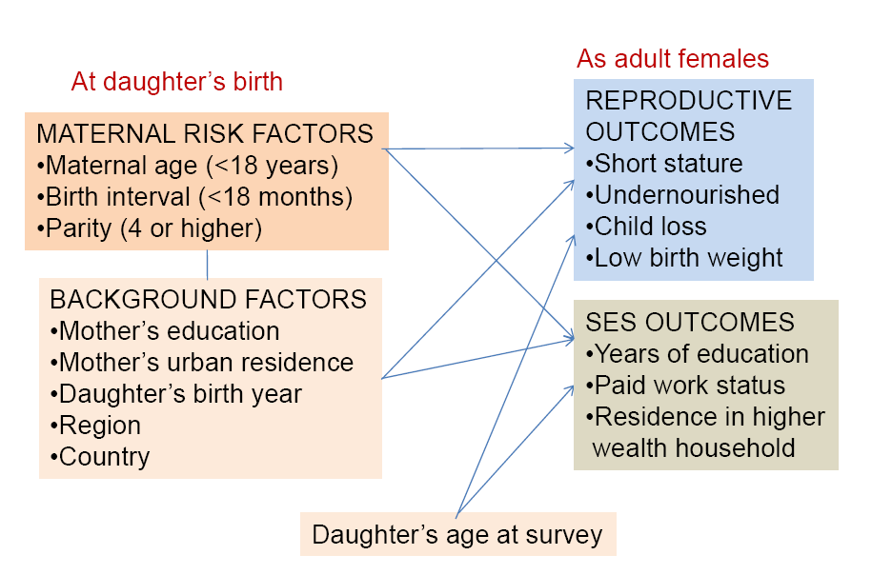
Analytic Framework Birth cohorts as units of analysis

Slide 5
Data and Methods
Capturing temporal change with repeated cross-sectional survey data in multiple countries
Pseudo-panel approach
Deaton (1985), used in other fields (labor economics)
A similar idea use for HIV incidence with 2 sequential DHSs in a given country (Hallett et al., 2010)
Extracts dynamics of life course change from DHS database of country-level surveys some 20 years apart
Construct single-year birth cohorts with DHS data
Data from DHS surveys conducted in 50 countries between 1986 and 2012

Slide 6
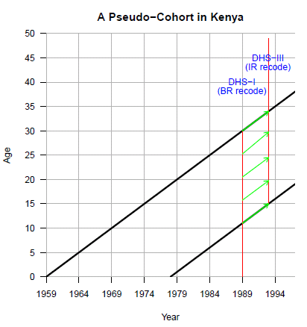
Paired sequential DHSs
Constructed single year birth cohorts
Used data on all children to
respondents in the 1st DHS to
obtain maternal risk factors
Used data on individual respondents
in the 2nd DHS for reproductive
outcomes
Linked the two by birth cohort year
(pseudo-panel)
Example for Kenya 1993 DHS reproductive outcomes
for a woman age 17 is linked to
to her cohort counterpart in
1989 DHS (aged 13), using her
child birth information and that of
her mother (as a survey respondent)

Slide 7
Paired sequential DHSs
Constructed single year birth cohorts
Used data on all children to
respondents in the 1st DHS to
obtain maternal risk factors
Used data on individual respondents
in the 2nd DHS for reproductive
outcomes
Linked the two by birth cohort year
(pseudo-panel)
Example for Kenya 1993 DHS reproductive outcomes
for a woman age 25 is linked to
to her cohort counterpart in
1989 DHS (aged 21), using her
child birth information and that of
her mother (as a survey respondent)
Adult females
interviewed in
1993
Children
reported by
adult females
interviewed
in 1989

Slide 8
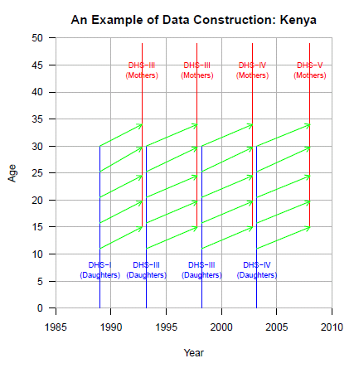
In this example, pseudo-cohorts are constructed with four
pairs of surveys
Cohort sample for each country is formed and grouped
with other similarly constructed cohorts for other countries
(total of 50 across 4 regional
groupings)

Slide 9
Data Preparation
Constructed 2,542 single-year birth cohorts
Minimum of 100 women to increase the accuracy of the cohort-level measurements (M Verbeek et al.,1992)
1,386 from 27 Sub-Saharan African (SSA) countries
Constructed covariates for maternal factors at birth by cohort
Attached cohort-specific maternal factors covariates to daughters-as-mothers cohorts

Slide 10
Statistical Model
Generalized linear regression models (GLM) for each of the 6 reproductive and 2 socioeconomic outcomes
Include regions as dummy variables with robust variance estimation to adjust for correlated observations within the region
Estimate the models for the full and SSA samples of cohorts

Slide 11
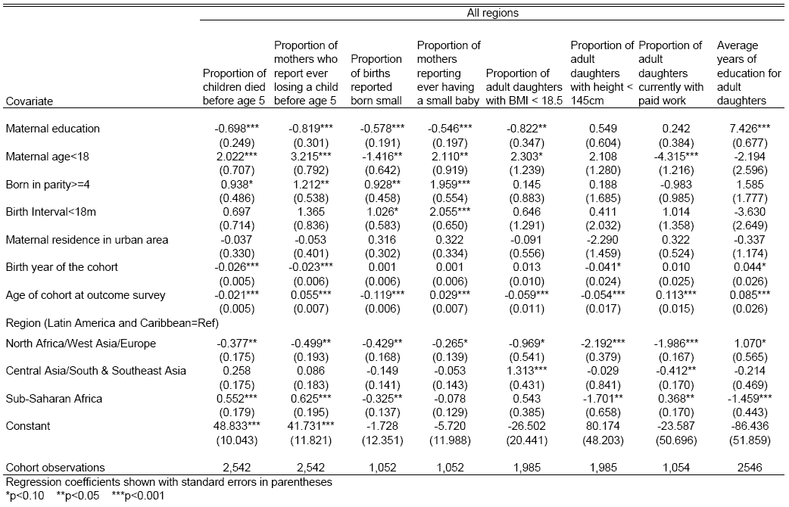
Results of Generalized Linear Model Estimation of Cohort Proportions for Reproductive and Socioeconomic Outcomes in 50 Developing Countries Regressed on Maternal Risk Factors, Maternal Attributes and Region

Slide 12
Results of Generalized Linear Model Estimation of Cohort Proportions for Reproductive and Socioeconomic Outcomes in 50 Developing Countries Regressed on Maternal Risk Factors, Maternal Attributes and Region
The effect sizes are sizeable,
mostly in the expected direction,
and often statistically significant

Slide 13
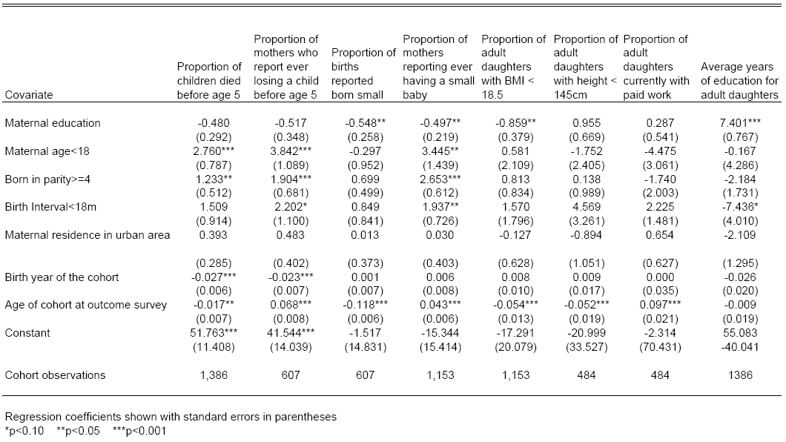
Results of Generalized Linear Model Estimation of Cohort Proportions for Reproductive and Socioeconomic Outcomes in 27 Sub-Saharan African Countries Regressed on Maternal Risk Factors and Attributes

Slide 14
Results of Generalized Linear Model Estimation of Cohort Proportions for Reproductive and Socioeconomic Outcomes in 27 Sub-Saharan African Countries Regressed on Maternal Risk Factors and Attributes
Stronger effects in SSA,
mostly in the expected direction

Slide 15
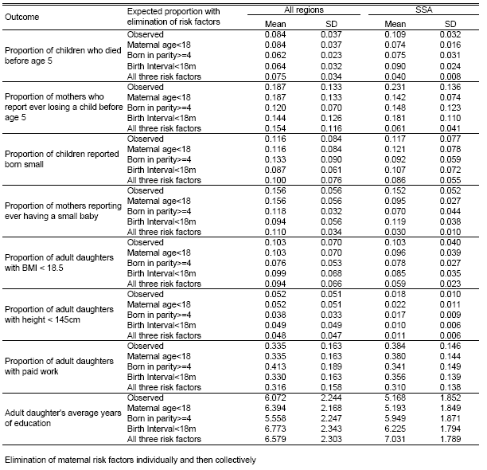
Observed Cohort Proportions and Simulated Proportions with Maternal Risk Factor Eliminated: All Regions and Sub-Saharan Africa Only
RH outcome

Slide 16
Observed Cohort Proportions and Simulated Proportions with Maternal Risk Factor Eliminated: All Regions and Sub-Saharan Africa Only
Developmental outcome

Slide 17
Observed Cohort Proportions and Simulated Proportions with Maternal Risk Factor Eliminated: All Regions and Sub-Saharan Africa Only
SES outcome

Slide 18
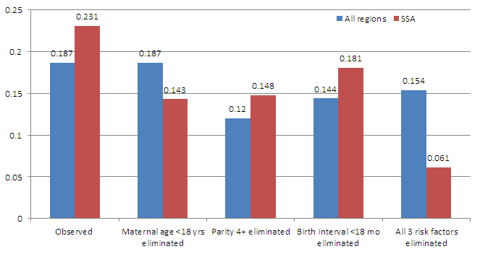
Results
Observed and Predicted Cohort Proportions of Mothers Experiencing Child Loss before Age 5 by Type of Maternal Risk Factor Eliminated and Region

Slide 19
Observed and Predicted Cohort Average Years of Education for Adult Daughters by Type of Maternal Risk Factor Eliminated and Region
Simulation scenario | All regions | SSA
Observed | 6.07 | 5.17
Maternal age <18 yrs eliminated | 6.39 | 5.19
Parity 4+ eliminated | 5.56 | 5.95
Birth interval <18 mo eliminated | 6.77 | 6.23
All 3 risk factors eliminated | 6.58 | 7.03

Slide 20
Across the three reproductive risks, eliminating early childbearing shows the highest gain in the mean proportion having paid work--from 0.286 to 0.326.
The individual elimination of the other two risk conditions does not increase the mean cohort proportion with paid employment;
However, the elimination of all three does raise it from 0.286 to 0.305.

Slide 21
Findings
Eliminating 3 maternal risk factors in overall and SSA samples
Lowers the observed level of adverse reproductive health outcomes
Increases average years of schooling for adult daughters,
Appears to increase proportion in highest wealth households
Analysis supports hypothesized linkages between maternal childbearing indicators, adult health measures and socioeconomic wellbeing.
One of first applications of pseudo panel approach to public health outcomes
Because maternal risks are preventable, findings show potential to prevent adverse birth outcomes over long run and in an enduring manner

Slide 22
Conclusions
The findings suggest further research to capture the complexities of female employment, while contributing to the understanding of how investments in reproductive, maternal and child health can produce healthy childbearing patterns that translate into improved quality of human capital and the Demographic Dividend.

Slide 23
Thank You 谢谢

