Slide 1
Overview of Demographic Dividend
Andrew Mason
Demographic Dividend Working Group
Barcelona, Spain June 5-8, 2013

Slide 2
First Demographic Dividend
At an early stage of [demographic] transition, fertility rates fall, leading to fewer young mouths to feed. During this period, the labor force temporarily grows more rapidly than the population dependent on it, freeing up resources for investment in economic development and family welfare.
-- Lee and Mason (2006)

Slide 3
Second Demographic Dividend
A second dividend is also possible. A population concentrated at older working ages and facing an extended period of retirement has a powerful incentive to accumulate assets—unless it is confident that its needs will be provided for by families or governments.
-- Lee and Mason (2006)

Slide 4
Consumption Identity

Slide 5
Effective producers and consumers

Slide 6
Two Dividends
Channel for first dividend:
Increase in the support ratio (L/N) holding other factors, saving and income per effective worker, constant.
Channel for second dividend:
Changes in saving and capital per effective worker influence income, from labor and assets, per effective worker.

Slide 7
Support Ratio, China

Slide 8
Support Ratio, China
Net swing of 1.2% per year in per capita growth due to population age structure.
Plus 0.8% per year

Slide 9
Timing: First Dividend Phase
Lower income

Slide 10
First Dividend – Annual growth per year in percent
Boost to economic growth varies from 0.2 to 0.9% per annum.
Biggest gains in E and SE Asia.
Small gains in countries with slow fertility decline.

Slide 11
First Dividend – Total gain in consumption per equivalent adult
Total gain ranges from under 5% to over 45%.
Small gains in West and some LAC countries.
Large gains in parts of Africa, LAC, and Asia.

Slide 12
Important issues about the first dividend
Annual gain versus total gain.
Timing – sooner better than later.
Largest gains may occur in countries which started from a particularly disadvantaged position, i.e., very high fertility and high child dependency.
Influence of policy on the dividend
Reproductive health and fertility decline
Lifecycle polices (labor income and consumption)

Slide 13
Second Demographic Dividend
Aging leads to an increase in the demand for lifecycle wealth, i.e., the aggregate resources required to meet lifecycle needs.
Impact on assets depends on extent to which elderly depend on transfers vs assets to support their old-age consumption.
Quantifying the second demographic dividend requires a macroeconomic model including
Impact of population on saving (s) and capital (K)
Effect of capital on productivity (Y/L)

Slide 14
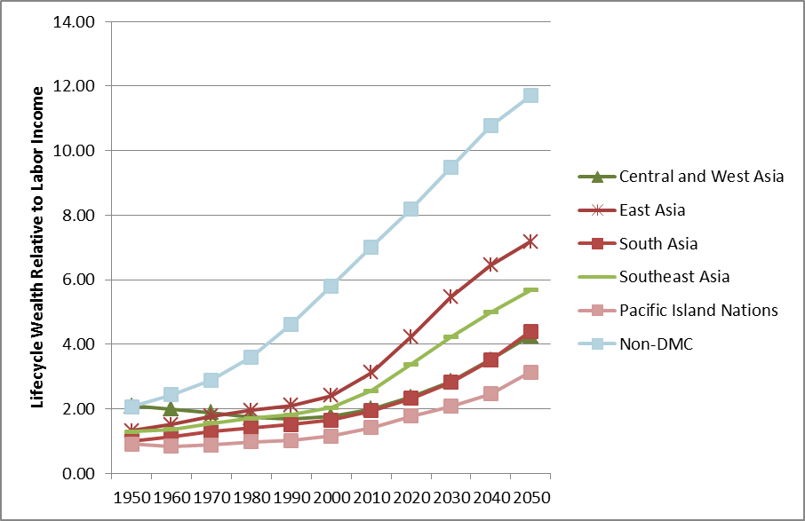
Lifecycle wealth, high-income profiles
Modest increase in DMC W before 2000 – about 1.5% faster than labor income.
W grows most rapidly in DMCs from 2010-20 at 2.8% faster than labor income.
Growth becomes more moderate in later decades, but always faster than labor income.

Slide 15
Extending second dividend to human capital
Tradeoff between fertility and human capital spending per child.
Aging societies will have fewer workers but they will be more productive due to their enhanced human capital.
Quantification requires model with
Tradeoff between fertility and human capital
Impact of human capital on productivity

Slide 16
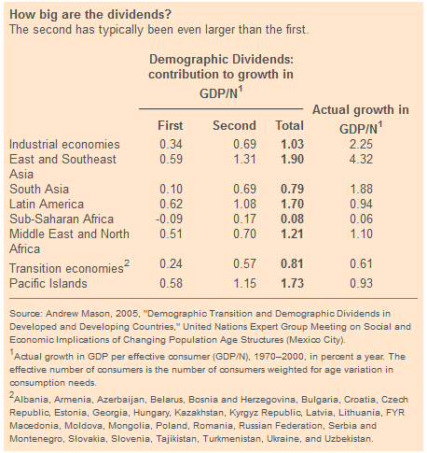
Source: Lee and Mason 2006 based on Mason 2005.

Slide 17
Bottom Line
The first and second demographic dividends can make an important contribution to economic growth.
The economic lifecycle influence both demographic dividends
Amounts consumed and produced at each age
Material needs in old age
Quantifying reallocation system essential to understanding how aging will influence the demand for assets to meet old-age needs.

Slide 18
References
Mason, A. (2005). Demographic Transition and Demographic Dividends in Developed and Developing Countries. United Nations Expert Group Meeting on Social and Economic Implications of Changing Population Age Structures, Mexico City.
Ronald Lee and Andrew Mason (2006) “What is the Demographic Dividend?” Finance & Development 43(3) September. http://www.imf.org/external/pubs/ft/fandd/2006/09/basics.htm
Mason, A. and R. Lee (2007). Transfers, Capital, and Consumption over the Demographic Transition. Population Aging, Intergenerational Transfers and the Macroeconomy. R. Clark, A. Mason and N. Ogawa, Elgar Press: 128-162.
Mason, A. and S.-H. Lee (2011). Population, Wealth, and Economic Growth in Asia and the Pacific. Aging, Economic Growth, and Old-age Security in Asia. D. Park, S.-H. Lee and A. Mason. Cheltenham, UK and Northamption, MA, Edward Elgar: 32-82.
Lee, R. and A. Mason (2010). "Fertility, Human Capital, and Economic Growth over the Demographic Transition." European Journal of Population 26(2): 159-182.

