Slide 1
Comparison of Internal Rates of Return from Intergenerational Transfer Systems
Michael R.M. Abrigo
Philippine Institute for Development Studies
and University of Hawai`i at Manoa

Slide 2
Background
Labor income does not match consumption at every stage of the lifecycle

Slide 3
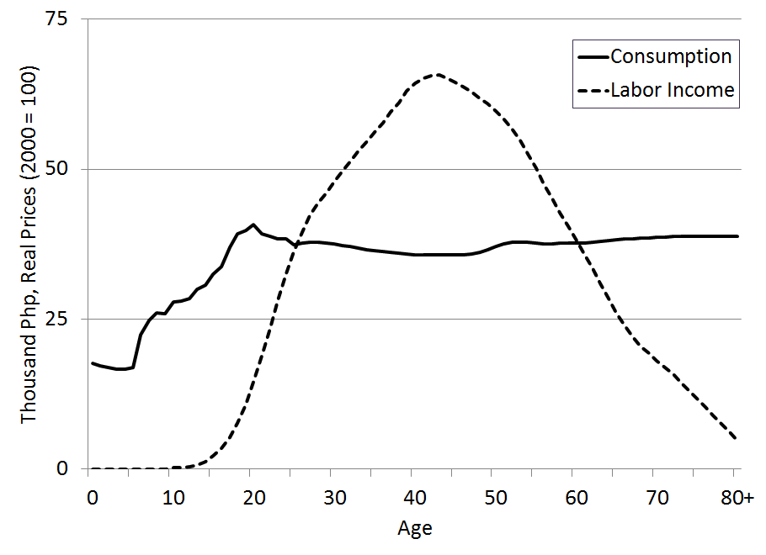
Background
Labor income does not match consumption at every stage of the lifecycle
Consumption and Labor
Income per capita Age Profile:
Philippines, 1999

Slide 4
Background
Labor income does not match consumption at every stage of the lifecycle
Surplus
Consumption and Labor
Income per capita Age Profile:
Philippines, 1999
Deficit
Deficit

Slide 5
Background
Deficit should be financed somehow: transfers from surplus ages, draw from savings, etc.
Surplus
Consumption and Labor
Income per capita Age Profile:
Philippines, 1999
Deficit
Deficit

Slide 6
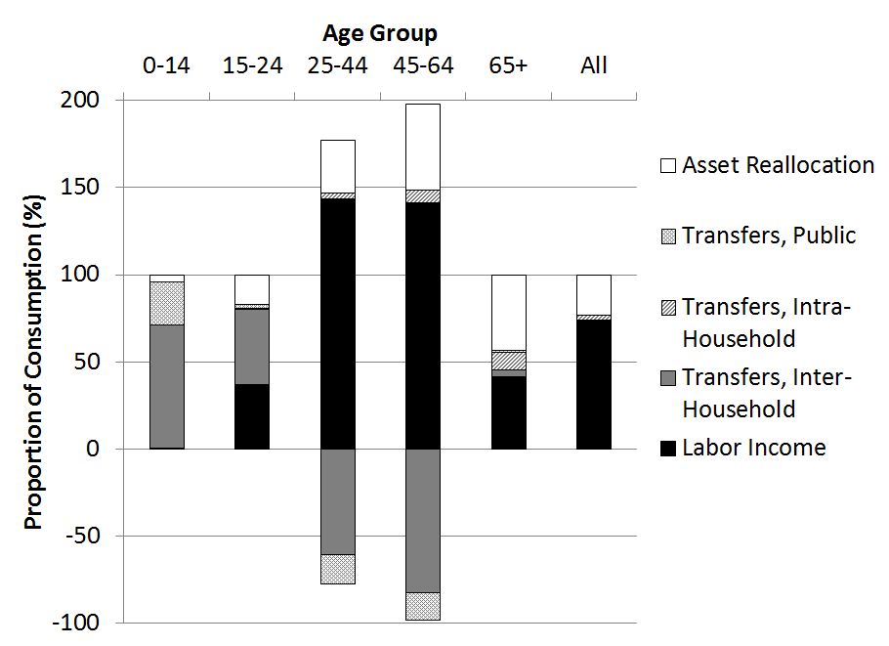
Background
Bottomline: Consumption is financed
Consumption Financing:
Philippines, 1999

Slide 7
Background
Economies finance lifecycle deficit differently

Slide 8
Question
How do people from different economies choose how to finance lifecycle deficit?

Slide 9
Objectives
Describe intergenerational transfer systems
Relate measure with theory

Slide 10
Literature
Describe intergenerational transfer systems
Lee Arrows: Lee (1994), Patxot, et. al. (2012)
Transfer Wealth: Kotlikoff and Summers (1981) Bommier and Lee (2003), Lee and Mason (2011)
Rate of Return: Auerbach and Lee (2011)

Slide 11
Literature
Relate measure with theoretic predictions
Test of motives: Lillard and Willis (1997)
Private transfers: Lee and Donehower (2011)

Slide 12
Measuring Rate of Return
Usual internal rate of return (IRR) not unique if net flows change sign more than once
Limits application to characterizing intergenerational transfer systems
Modified IRR does not share this weakness

Slide 13
Modified IRR
Compares future value of inflows against present value of outflows
$$mIRR=\sqrt[T]{\frac{\sum_{t}{Y^{+}\left(1+r_{r}\right)}}{\sum_{t}{\frac{Y^{−}}{\left(1+r_{f}\right)}}}}−1$$
In steady state, interest rates are equal
Assumed $r_{r}$ and $r_{f}$ equal 10y bond rate

Slide 14
Data and Assumptions
Lee, R., A. Mason and members of the NTA network (2014). Is low fertility really a problem? Population aging, dependency and consumption. Science, 346, 229-234.
Assumptions
Age profiles represents expected lifecycle flows
Returns to intergenerational transfers are uncorrelated with returns to assets

Slide 15
Are Transfer Systems profitable?
Yes: Computed mIRRs > 0
Excess return computed as
survival-weighted modified
Internal Rate of Return less
10y bond rate

Slide 16
Are we close to steady state?
No?
Red lines are sample
averages

Slide 17
Implication
If actual $r_{r}$ and $r_{f}$ rates are higher than 10y bond rates, then mIRR are lower bounds
Non-altruistic motives are possible since expected rates of return are positive

Slide 18
Do we live in Markowitz world?
Non-altruistic agents mix investment options to maximize expected returns subject to risks (Markowitz, 1952)
Predicts that relationship between investment shares depends on rates of return and risks
Assumed returns of intergenerational transfer systems are uncorrelated with asset returns

Slide 19
Do we live in Markowitz world?
Maybe. Probably no.
Plot compares Markowitz-theoretic
predicted ratio of private to public
transfers outflows against observed
ratio

Slide 20
Implication
People are not perfectly self-interested
Altruism and institutional design can be accommodated to explain distribution of intergenerational transfers, although profit-motive cannot be entirely ruled out

Slide 21
Summary
Data rejects Markowitz problem
Supports Fama and French (1992)
People are not one dimensional
Supports Lillard and Willis (1997)

Slide 22
(Thank you very much!)
mmabrigo@gmail.com

